Slide 1
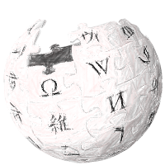
Kyoto University
Design Summer School
2012
Redesigning Wikipedia for Education
Project Report
Summary By: Kourosh Meshgi
Redesigning Wikipedia for Education – Kourosh Meshgi

Slide 2
Contents
School Information
Workshop: Design Thinking
Workshop: Brainstorming
Project Theme
Introductory Presentations
Project Progress
Deliverables
Redesigning Wikipedia for Education – Kourosh Meshgi

Slide 3
School Info
Redesigning Wikipedia for Education – Kourosh Meshgi

Slide 4
General Info:
Date September 24 (Mon.) – September 26 (Wed.)
Location Kyoto Research Park
Organizer
Graduate School of Informatics, Kyoto University
Graduate School of Management, Kyoto University
Co-organizer
Faculty of Fine Arts, Kyoto City University of Arts
Graduate School of Engineering, Kyoto University
Academic Center for Computing and Media Studies, Kyoto University
Redesigning Wikipedia for Education – Kourosh Meshgi

Slide 5
Presentation Schedule
A会場 （KISTIC 2階 イノベーションルーム）
13:00 発表会オープニング
13:10～13:35 「日本文化を題材として、写真で表現するもてなしのデザイン」
13:35～14:00 「電気のいらない家電製品をデザインする」
14:00～14:25 「『みる』クロッキー実習」講評
14:25～14:50 「産学連携の拠点となる『フューチャーセンター』をデザインする」
14:50～15:15 「次世代型ワークプレイスを若い視点で創出する」
15:30～15:55 「ものづくりワークショップ：人と人とをつなぐ『コミュニテリア』のデザイ ン」
15:55～16:20 「将来のコミュニケーションサービスのデザイン」
16:20～16:45 「ユーザと機器の対話のデザイン」
16:45～17:10 「『からだの情報化』が拓く健康社会のデザイン」
17:10～17:30 講評～クロージング
B会場 （4号館 2階 ルーム1）
13:00 発表会オープニング
13:10～13:35 「歩車混合のまちなか交通を考える」
13:35～14:00 「Redesigning Wikipedia for Education」
14:00～14:25 「動画メディアにおけるリアルタイムコメントのデザイン」
14:25～14:50 「不便益なシステムのデザイン」
14:50～15:15 「盗難問題を解決した自転車のデザイン」
15:30～15:55 「料理人と顧客の価値共創を促す情報メディアのデザイン」
15:55～16:20 「日本茶の海外展開のデザイン」
16:20～16:45 「メディア化する新しいコミュニケーションカフェのデザイン」
16:45～17:10 「町家を生かした知の拠点づくり」
17:10～17:30 講評～クロージング 発表形式
持ち時間（計: 25分） 発表: 15分 質疑: 10分 （最後に3分程度の実施者からのコメントをいただきます）
Redesigning Wikipedia for Education – Kourosh Meshgi

Slide 6
Goals & Format:
Participants divided into teams and work on various themes related to “Design”→ a presentation for each team at the end of the event
Learning schemes
PBL (Problem Based Learning)
FBL (Field Based Learning)
Solve complicated problems by learning and utilizing design theory, methodology and techniques + their own expertise about informatics, engineering, management and so on.
Redesigning Wikipedia for Education – Kourosh Meshgi

Slide 7
The Team
Redesigning Wikipedia for Education – Kourosh Meshgi

Slide 8
Theme Participants
Fabian Jander (Department of Architecture and Environmental Engineering, Kyoto University)
Maridian Wushouer (Department of Social Informatics, Graduate School of Informatics, Kyoto University)
Kourosh Meshgi (Department of Systems Science, Graduate School of Informatics, Kyoto University)
Redesigning Wikipedia for Education

Slide 9
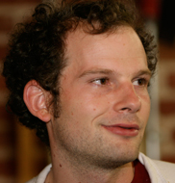
Honorable Presence
Adam Royalty (d-School, Stanford University)
http://dschool.stanford.edu/bio/adam-royalty/
Sungene Ryang (IDEO Tokyo)
http://www.ideo.com/people/sungene-ryang
Redesigning Wikipedia for Education

Slide 10
Theme Organizers
Jonas Elslander (Department of Social Informatics, Graduate School of Informatics, Kyoto University)
Adam Jatowt (Department of Social Informatics, Graduate School of Informatics, Kyoto University)
Makoto P. Kato (Department of Social Informatics, Graduate School of Informatics, Kyoto University)
Redesigning Wikipedia for Education – Kourosh Meshgi

Slide 11
Topic
Redesigning Wikipedia for Education – Kourosh Meshgi

Slide 12
Project Theme
Redesigning Wikipedia for Education – Kourosh Meshgi

Slide 13
Wikipedia for Education
Successful collaboration of multiple users
Encyclopedic body of knowledge
Frequently visited by users
Searching information on unknown/difficult topics
Satisfactory level of accuracy
Wikipedia articles are still not useful for learning purposes
Redesigning Wikipedia for Education – Kourosh Meshgi

Slide 14
Problem of Learning from Wikipedia
Complexity
Lots of expert vocabulary
Lack any introduction necessary for non-expert users
Navigation for Education
Links do not show educational trails /structured knowledge
Acquiring information step-by-step is difficult
Redesigning Wikipedia for Education – Kourosh Meshgi

Slide 15
Introductory Talks
Redesigning Wikipedia for Education – Kourosh Meshgi

Slide 16
Problems in Wikipedia from Learning Viewpoint (1/2)
Articles on difficult topics are often poorly comprehensible
Lots of Expert vocabulary and lack of introduction necessary for non-expert users
e.g: “In carbohydrate chemistry, an anomer is a special type of epimer. It is one of two stereoisomers of a cyclic saccharide that differs only in its configuration at the hemiacetal or hemiketal carbon, also called the anomeric carbon.[1] Anomerization is the process of conversion of one anomer to the other. Anomerization is the anomeric analogue of epimerization…”
Redesigning Wikipedia for Education – Kourosh Meshgi

Slide 17
Example that Lacks Conceret Language
Wikipedia: “Parkinson's disease affects movement, producing motor symptoms.[1] Non-motor symptoms, which include autonomic dysfunction, neuropsychiatric problems (mood, cognition, behavior or thought alterations), and sensory and sleep difficulties, are also common…”
Other Ref: “Patient will begin to notice early signs of Parkinson's. These may include mild shaking or tremors in one limb. Patients may experience occasional loss of balance. Patient may begin to experience symptoms on both sides of their body. Shaking may regularly occur in all limbs. Uncontrollable shaking affects patient's ability to walk, stand, and maintain balance. Patient may encounter difficulty handling otherwise simple tasks...”
Redesigning Wikipedia for Education – Kourosh Meshgi

Slide 18
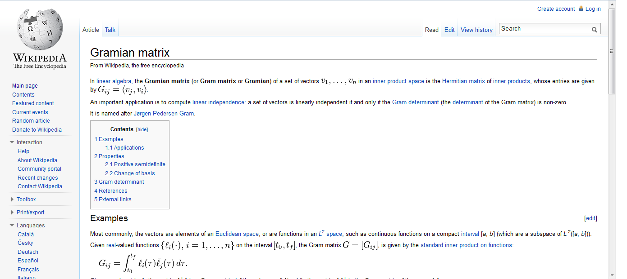
Another Example
Redesigning Wikipedia for Education – Kourosh Meshgi

Slide 19
Problems in Wikipedia from Learning Viewpoint (2/2)
2. Lack of educational trails or structured knowledge for users
Difficult to assimilate knowledge step by step
Difficult to navigate Wikipedia
Easy to lose viewpoints or the sense of relation
3. Difficulty in extracting higher level knowledge such as comprehension of different entities/topics or their relations
e.g: comparing political, social and economical impact of World War I and World War II
Redesigning Wikipedia for Education – Kourosh Meshgi

Slide 20
Wikipedia and Learning
Encyclopedic character
Good for checking particular information (e.g. one on concrete entity or a specific aspect thereof)
Not effective for cross-topic or associative learning
Collaborative Editing
“Expert-corrects-expert” situation
Accuracy and correctness are preferred over simplicity, generalizing and teaching
Redesigning Wikipedia for Education – Kourosh Meshgi

Slide 21
Users
Average internet users is not an expert!
Many users have problems with understanding of reading material
e.g. about 21% of the adult population in USA have low literacy skills, defined as reading at the 6 grade or less
Another 27% have limited literacy ability, defined as lacking general reading and numeric proficiency to function adequately in society
In addition, for many Wikipedia users English may not be the first language
Redesigning Wikipedia for Education – Kourosh Meshgi

Slide 22
Readability Measures: Syntactic Metrics
Flesch Reading Ease (FRE)
206.876 – 1.015 ASL – 84.6 ASW
ASL: Average # of syllabus per word
ASW: Average # of words per sentence
Automated Readability Index (ARI)
4.71(C/W) +0.5(W/S)-21.43
C: # of characters
W: # of words
S: # of sentences
Coleman Liau Index (CLI)
0.0588L – 0.296S – 15.8
L: Average # of letters per 100 words
S: Average # of sentence per 100 words
New Dale-Chall Formula (NDC)
A combination of syntactic and popularity-based formulas
Considers both the average sentence length and the # of difficult words
Difficult words: not a member of 3,000 common words fixed list
Redesigning Wikipedia for Education – Kourosh Meshgi

Slide 23
Rest of Introductory Material
To be filled soon
Redesigning Wikipedia for Education – Kourosh Meshgi

Slide 24
Project Progress
Redesigning Wikipedia for Education – Kourosh Meshgi

Slide 25
Progress Outline:
Design Research & Inspiration
Brain Storming on SWOT Matrix
Defining Stakeholders
Reframing: Needs & Insights
Brain Storming on Desirables
Ideate
Design Direction
Feedback
Prototyping & Testing
Materialization of Design
Discussion
Redesigning Wikipedia for Education – Kourosh Meshgi

Slide 26
Design Research:SWOT Matrix Brainstorming
Problem: RE-design
SWOT Matrix
Strengths
Weaknesses
Opportunities
Threats
Needs to Define Stakeholders
Brainstorming
Events
Experiences
Domain Knowledge
Feelings
Motivations
Both Feasible & Wild Ideas
Hopes
Behaviors
Aspirations
Needs
Redesigning Wikipedia for Education – Kourosh Meshgi

Slide 27
Stakeholders (Regarding Education)
Students with Bad Teachers
Students who Want To Learn Deeply
Students near Deadlines, Examination Nights, Panic Mode!
Students who are Good in IT
Students who Have No Idea About the Topic, Explorers
Primary School Students who Want to Conduct “Free Research”
Students with Bad Economic Situations
PhD Students want to Understand Something from Another Major e.g. Socialogy Students looking for Mathematical Tool
“Know It All” Children, Curious
Elderly People
In-Home Education Guys
Redesigning Wikipedia for Education – Kourosh Meshgi

Slide 28
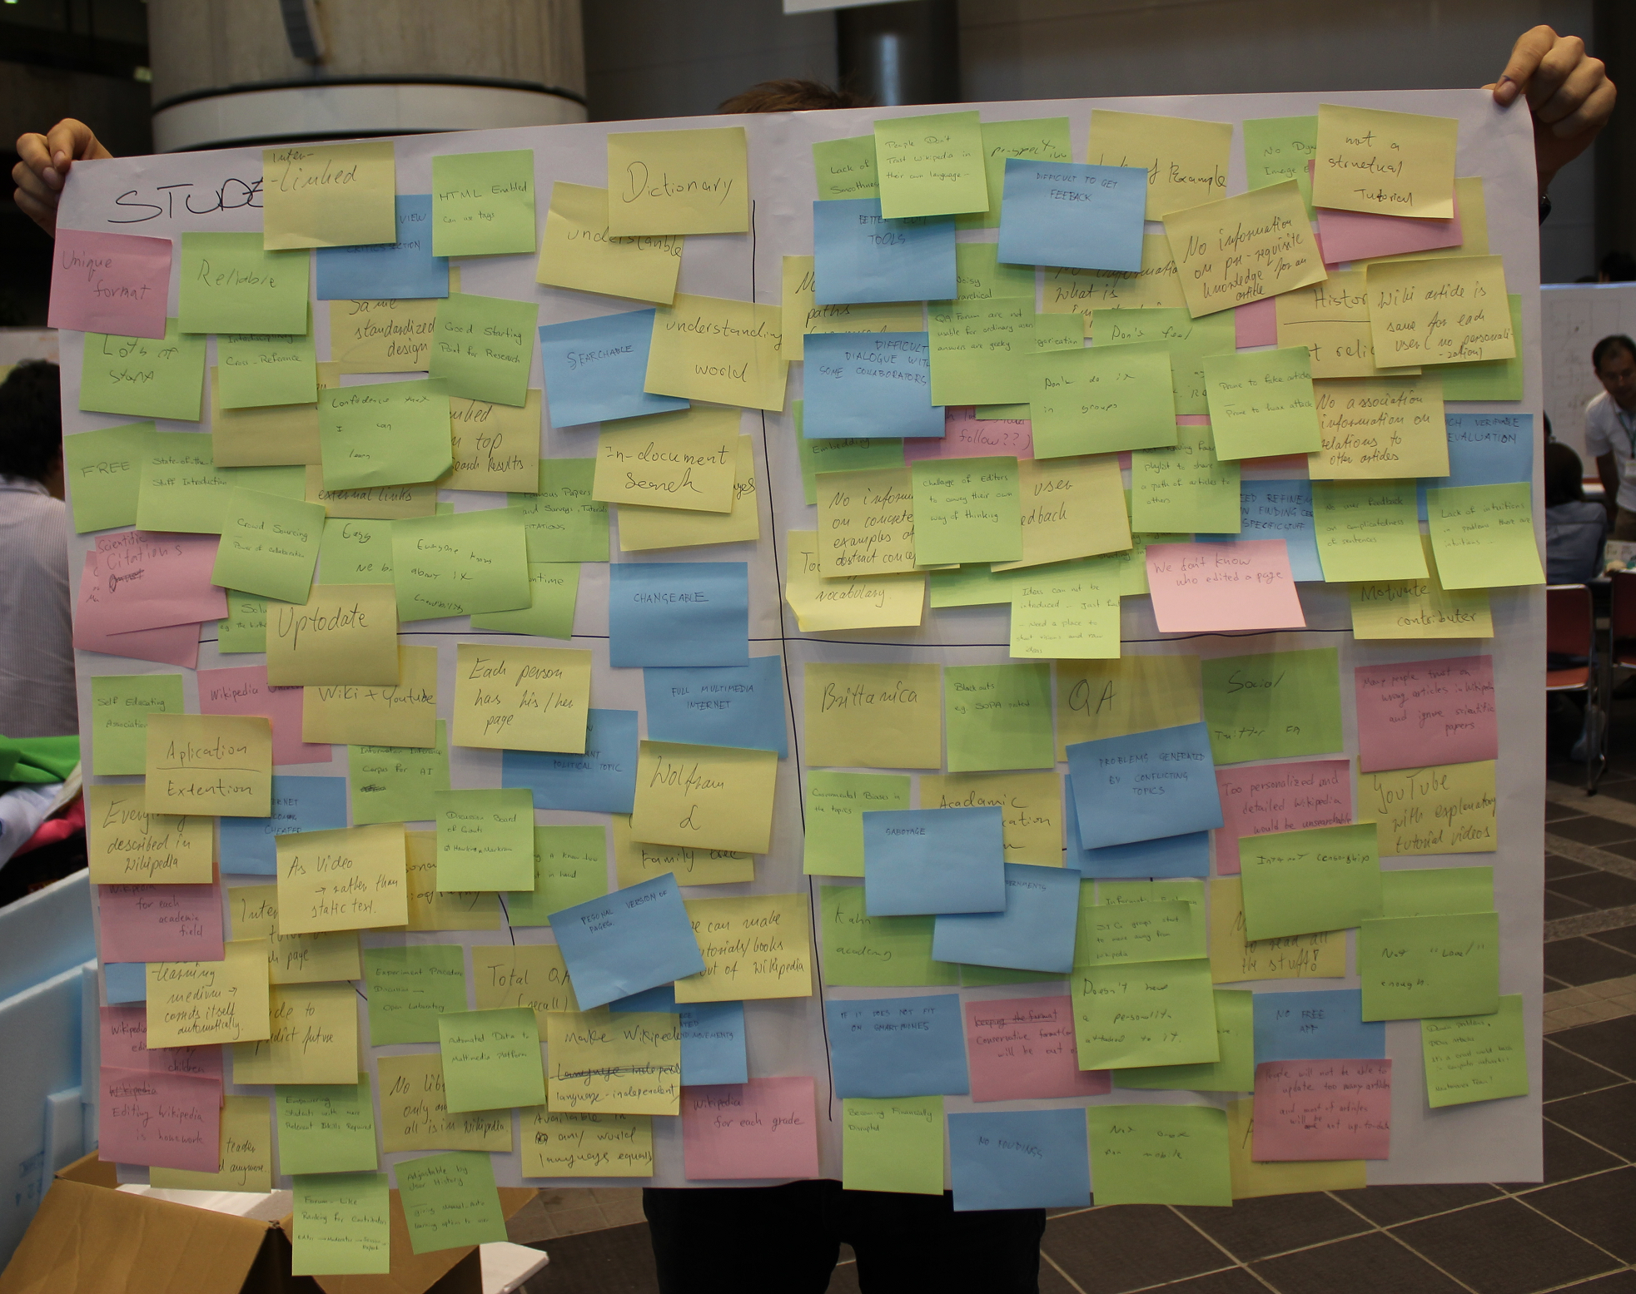
Topic
a
Redesigning Wikipedia for Education – Kourosh Meshgi

Slide 29
Strengths:
Easy, No Barrier
No Downtime
Changeable
Famous Paper, Survey, Tutorial Citation
Similar Languages
In-document Search
Ranked on Top of Search Results
Good Reference Citation to External Links
Confidence That I Can Learn
Interdisciplinary Cross-Reference
Same Standardized Design
Point of View Citation Section
Good Starting Point of Research
HTML Enabled, Can use Tags
Understandable
Dictionary
Wiktionary
Interlinked
Reliable
Lots of Stuff
Credibility, Everyone Knows About It
Famous Problem Solutions e.g. The Birthday Problem
Up-to-Date
Understanding World
Searchable
Free
Unique Format
Introductory to State-of-the-Art
Fast
Crowd Sourcing, Power of Collaboration
Scientific Citation
Multi Lingual
Redesigning Wikipedia for Education – Kourosh Meshgi

Slide 30
Weaknesses:
People Don’t Trust Wikipedia in their own Language
Bad Edit Tools
Lack of Article Smoothness
One Perspective
No Education Paths, Sequences for Learning
Difficult To Get Feedback
Lack of Example
QA Forum are not Usable for Ordinary Users, Answers are Geeky
No Information on Pre-requisite Knowledge For an Article
Difficult Dialogue with Some Collaborators
Noisy Hierarchical Structure, Low Supervision
Don’t Do it in Groups
Don’t Feel I can Edit as a Student
Try to be Neutral which is Sometimes Boring
No Dynamic Image Embedding
No Categorization of Article Complexity
No Information about What is Important in the Page
Too Difficult Vocabulary
No Target of Article, Just Shooting Info
Challenges of Editors to Push their own Way of Thinking
No User Feedbacks
No Concrete Example of Abstract Concepts
No Video Embedding
Too Much Details
Redesigning Wikipedia for Education – Kourosh Meshgi

Slide 31
Weaknesses: (cntd.)
New Ideas Cannot be Introduced, No Future Works Directions, Just Facts, Need a Place to Shoot Visions and Raw Ideas
Many Links, Which One I shall Follow?
Not Individualized
Prone to Fake Articles, Hoax Attacks, …
Precise but Long Sentences
We don’t Know Who Edited the Page
Bad User Interface
Static Pages
Not Having Favorite Playlist to Share a Path of Articles to others
Need Refinement in Finding Certain Specific Stuff
No Explicit Entrance
Need History, Not Reliable
No Motivation for Contributors
Articles are Same for Every User, No Personalization
Not a Structural Tutorial
Lack of Intuitions
No Association Information on Relation to Other Articles
Not Much Verifiable Evaluation
No User Feedback on Complicatedness of Sentences
Redesigning Wikipedia for Education – Kourosh Meshgi

Slide 32
Opportunities:
Information Available in any World Language Equally
Oracle to Predict Future
Self Educating Association
Applications, Extensions
Wikipedia University
Everything Described in Wikipedia
No more Human Teachers
Editing Wikipedia as Homework
Wikipedia Edited Only by Children
Internet Become Cheaper
Information Inference Corpus for AI
As Video, rather than Static Text
Wikipedia for Each Academic Field
Self Learning medium, Corrects itself Automatically
Develop for Use in Schools
Open Source and Related Trends and Movements
Family Tree, Saving the Knowledge of Old People
Interactive Tutor on each Page
Empowering Students with more Relevant Skills and Knowledge
Education is an Important Political Topic
Having a Know-How Robot in Hand
Discussion Board of Giants e.g. Hawking vs. Darwin
Personal Biograpy
Redesigning Wikipedia for Education – Kourosh Meshgi

Slide 33
Opportunities: (cntd.)
Automatic Data-to-Multimedia Platform
Making Wikipedia Language Independent
Total QA, Recall
No Libraries, All Knowledge could be Found in Wikipedia
Forum-like Ranking for Contributors e.g. Editor → Moderator → Expert
Adjustable by User History, Giving Manual/Auto Options to User
Wikipedia for each Grade
Make Tutorials/Book in Wikipedia
Personal Version of Pages
Wolfram Alpha
Full Multimedia Internet
Experiment Procedure Discussion, Open Laboratory
Each Person has His/Her Page
Wikipedia + YouTube
Academic Communication Platform
Redesigning Wikipedia for Education – Kourosh Meshgi

Slide 34
Threats:
Conservative Format/Structure, Will be Out-of-Date
No Funding
Becoming Financially Disrupted
If it does not Fit on Smartphones
Brittanica
Blackouts e.g. SOPA Protest
Sabotage
Govermental Biases in Topics
No Time to Read all the Stuff!!
Certain Governments
Not “New” Enough
Khan Academy
Not Great for Cellphone
Many People Trust a Wrong Article in Wikipedia and Ignore Scientific Papers
Not “Local” Enough
Not “Cool” Enough
No Free App
Advertisement
Social Networks
Internet Censorship
ITunes, CIA, …
YouTube with Explanatory Tutorial Videos
Domain Problems, DDOS Attacks, Cruel World of Computer Networks, Maintenance team?
People will Not be able to Update many Articles, and most of the Articles will not be Up-to-Date
Problems Caused by Conflicting Topics
Redesigning Wikipedia for Education – Kourosh Meshgi

Slide 35
Threats: (cntd.)
Too Personalized and Detailed Wikipedia would be Unsearchable
Q&A
Doesn’t Have A Personality Attached to It
SIGs Start to Move Away from Wikipedia
Better Rival Platforms
It is Responsive not generative
Information Explosion, Too much Useless Info
Redesigning Wikipedia for Education – Kourosh Meshgi

Slide 36
Needs & Insights: Desirables Recognition
Desirables
Design Principle for Inspiration
Not Necessarily in Each New Idea
Progress
Brain Storming
Categorizing
Voting
Prioritizing
Defining Satisfactory Threshold
Redesigning Wikipedia for Education – Kourosh Meshgi

Slide 37
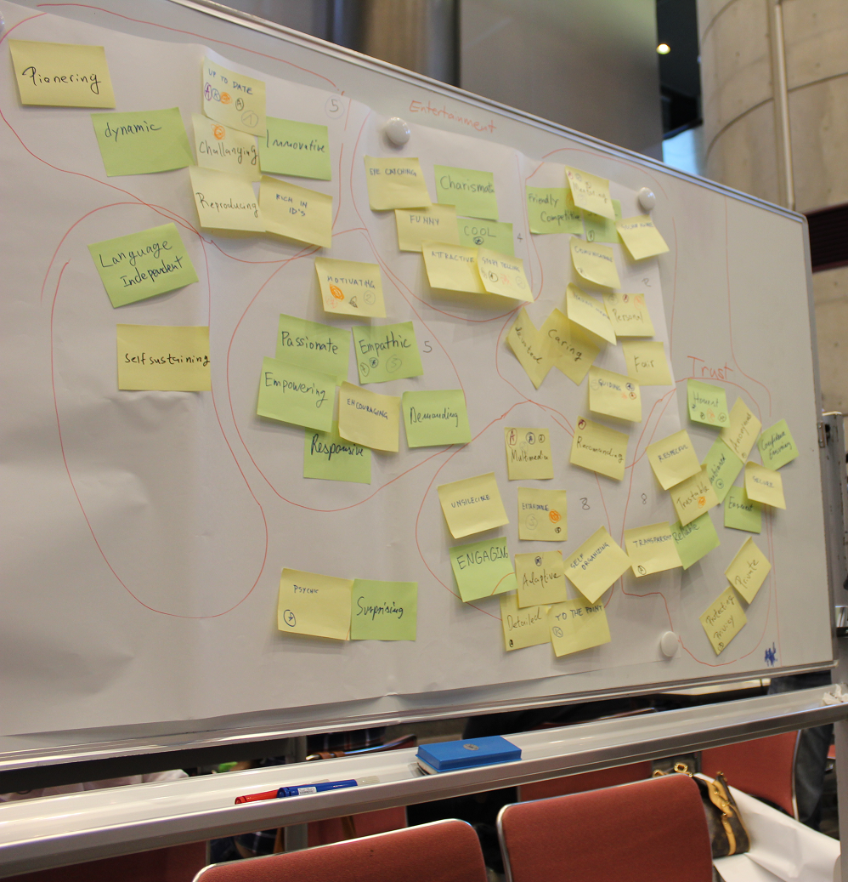
Needs & Insights: Desirables Recognition
Design Principle
for Inspiration
Redesigning Wikipedia for Education – Kourosh Meshgi

Slide 38
Desirables:
ENTERTAINMENT
Eye Catching
Charismatic
Cool
Story Telling
Attractive
Funny
CONTENT
Multimedia
Extendable
Unsilancable
Engaging
Adaptive
Detailed
To The Point
Self Organizing
Redesigning Wikipedia for Education – Kourosh Meshgi

Slide 39
Desirables:
ENTERTAINMENT (4)
Eye Catching
Charismatic
Cool (1)
Story Telling (3)
Attractive
Funny
CONTENT (8)
Multimedia (3)
Extendable (2)
Unsilancable
Engaging
Adaptive (1)
Detailed (1)
To The Point (1)
Self Organizing
Redesigning Wikipedia for Education – Kourosh Meshgi

Slide 40
Desirables:
INTERACTION
Mentoring
Friendly Competitive
Social
Socially Aware
Communicable
Having Memory
Personal
Fair
Caring
Devoted
Guiding
Recommending
TRUSTWORTHY
Honest
Anonymous
Unbiased
Confidence Ensuring
Secure
Earnest
Private
Protecting Privacy
Reliable
Transparent
Trustable
Redesigning Wikipedia for Education – Kourosh Meshgi

Slide 41
Desirables:
INTERACTION (12)
Mentoring (3)
Friendly Competitive (1)
Social (1)
Socially Aware
Communicable (1)
Having Memory
Personal (2)
Fair
Caring
Devoted
Guiding (3)
Recommending (1)
TRUSTWORTHY (8)
Honest (3)
Anonymous (1)
Unbiased (1)
Confidence Ensuring
Secure
Earnest
Private
Protecting Privacy (1)
Reliable
Transparent (1)
Trustable (1)
Redesigning Wikipedia for Education – Kourosh Meshgi

Slide 42
Desirables:
PERSONALITY
Motivating
Passionate
Empathic
Empowering
Encouraging
Demanding
Responsive
PIONEERING
Pioneering
Dynamic
Challenging
Up-to-Date
Innovative
Reproducing
Rich in Ideas
Redesigning Wikipedia for Education – Kourosh Meshgi

Slide 43
Desirables:
PERSONALITY (5)
Motivating (3)
Passionate
Empathic (2)
Empowering
Encouraging
Demanding
Responsive
PIONEERING (5)
Pioneering
Dynamic
Challenging (1)
Up-to-Date (4)
Innovative
Reproducing
Rich in Ideas
Redesigning Wikipedia for Education – Kourosh Meshgi

Slide 44
Desirables:
MISC
Psychic
Language Independent
Surprising
Self Sustaining
Redesigning Wikipedia for Education – Kourosh Meshgi

Slide 45
Desirables:
MISC (1)
Psychic (1)
Language Independent
Surprising
Self Sustaining
Redesigning Wikipedia for Education – Kourosh Meshgi

Slide 46
Final Desirables & Satisfactory Criteria:
100%
Story Telling
Honest
Motivating
Multimedia
Mentoring
Guiding
30%
50%
Up-to-Date
Personal
Empathic
Extendable
Redesigning Wikipedia for Education – Kourosh Meshgi

Slide 47
Design Directions:
Article Generation/Edition Checking Service
Personalizing User Interface
Extension Directions
Smart Wikipedia
+ Feedbacks effected
Radical
4
3
Human
Tech.
1
2
Incremental
Redesigning Wikipedia for Education – Kourosh Meshgi

Slide 48
Article Generation/Edition Check Service:1
Presented By Kourosh Meshgi
Automatic Service Call for Each New Article Generation/Edition Service
Feasible, Technical
Brings Value Added by Data Mining
Principles Covered: Up-to-Date, Story Telling, Guiding, Honest, Extendable
Redesigning Wikipedia for Education – Kourosh Meshgi

Slide 49
Article Generation/Edition Check Service:2
Article Generation Checks and Updates:
Validity
Author
Category
Connection
Personae
Redesigning Wikipedia for Education – Kourosh Meshgi

Slide 50
Article Generation/Edition Check Service:3
Validity Check:
Inconsistency Detection
Topic Analysis
Topic Suggestion
Author Tag Suggestion
Tone Analysis → Biased?
Related Multimedia Suggestion e.g. Images, Videos …
Automatic Alerts
Related Authors
Previous Article Authors
(If Biased) Article Category Moderators
Potential/ Subscribed Readers
Redesigning Wikipedia for Education – Kourosh Meshgi

Slide 51
Article Generation/Edition Check Service:4
Author Data Update:
Author Topic Analysis
Author Expertise Detection
Author Topic Proficiency Update
Author Tags
Author Links Analysis
H-Index in Wikipedia
Recommendations
Other People e.g. Experts, Related Authors, Q&A Active guys
Reading List
Ranking System
Popularity e.g. Like Forums (stars, thanks, thumbs-down, challenges received, responsiveness, etc.)
Readability Analysis + Article Complexity Analysis
Redesigning Wikipedia for Education – Kourosh Meshgi

Slide 52
Article Generation/Edition Check Service:5
Article Category:
Topic Category Identification e.g. Topic + TF-IDF + Cosine Similarity
Link Analysis
Contribution Analysis
Category Proficiency Level
Category Readability Level
Interdisciplinary Clarification Level
Category Need Analysis
E.g. Examples, Illustration, Simplification, Q&A Active Contributors,…
Issue Call for Participation
Redesigning Wikipedia for Education – Kourosh Meshgi

Slide 53
Article Generation/Edition Check Service:6
Article Connections:
Trend Analysis
Category Trends
Automatic Future Work Suggestion
Article Similarity / Partial Duplication
Plagiarism & Disclaimers
Automatic Citation → Resolving Plagiarism & Copyright
Author Credibility Assessment
Automatic Article Type Detection e.g. Survey, Application, Theory
Article Social Network Analysis
Cutting Points e.g. Celebrity Articles, Weak Chains, Cycles, …
Research Starting Point Suggestion e.g. Based on popularity, citation received, etc
Redesigning Wikipedia for Education – Kourosh Meshgi

Slide 54
Article Generation/Edition Check Service:7
Personae Analysis:
Article Proficiency/Understandibility Estimation
Reader Feedbacks
Anonymous Referees e.g. 1 Expert + 1 Related Author + 3 Interested Readers + 3 Random Visitors + 1 Good Readable Writer
Imaginary Personae
Ranking, Relevancy Detection
Contribution to whole Proficiency of Topic
Redesigning Wikipedia for Education – Kourosh Meshgi

Slide 55
Personalized User Interface:1
Presented By Fabian Jander
Changing User Interface, Enable Personalization
Feasible, Human-Centered
Brings Value Added by User-Friendliness
Principles Covered: Up-to-Date, Story Telling, Multimedia, Guiding, Personal
Redesigning Wikipedia for Education – Kourosh Meshgi

Slide 56
Personalized User Interface:2
Personalizable Toolbar
Pictures
Video
Definitions
Related Articles
Rating → Edit, Review, Feedback
History of Article
Statistics
Redesigning Wikipedia for Education – Kourosh Meshgi

Slide 57
Extension Direction:1
Presented By Mairidan Wushouer
Extending Wikipedia with Apps, APIs,…
Ambitious, Technical
Brings Value Added by Ease-of-Use and Innovativeness
Principles Covered: Up-to-Date, Story Telling, Multimedia, Empathic, Extendable
Redesigning Wikipedia for Education – Kourosh Meshgi

Slide 58
Extension Direction:2
Open APIs for Multimedia
Google Image Search, YouTube, Google Map, PhotoSynth, …
Apps
Open Apps
Invite and Motivate Programmers
Statistics, Data, Communicate, Connect
App Store
Family Tree
Redesigning Wikipedia for Education – Kourosh Meshgi

Slide 59
Extension Direction:3
Cross Linguistic
Machine Translation
Canonical Form of Data Presentation
Tutorials & Homework Sharing
Teachers for Students
Students for other Students
Students for other Students as Homework itself
Redesigning Wikipedia for Education – Kourosh Meshgi

Slide 60
Extension Direction:4
Redesigning Homework
Give an Open Challenge to a Group
Ask them To Collaborate in a Single Wikipedia Article
Tasks
Literature Review
Idea Generation
Consistency/Smoothness/Readability Review
Maybe: Brainstorming, Q&A …
Redesigning Wikipedia for Education – Kourosh Meshgi

Slide 61
Smart Wikipedia:1
Presented By Adam Royalty
Enable Wikipedia to Interact with World Through and Author
Ambitious, Technical + Human-Centered
Brings Value Added by Intelligence and Innovativeness
Principles Covered: Up-to-Date, Story Telling, Multimedia, Mentoring, Personal
Redesigning Wikipedia for Education – Kourosh Meshgi

Slide 62
Smart Wikipedia:2
Story telling
Learning about and Article by a Story
E.g. comic book, data from Facebook timeline
Smart Watches
Good Cop, Bad Cop → Rewarding and reminding Wikipedia Collaborators
Interact with World e.g. take pictures and give info or maps
Redesigning Wikipedia for Education – Kourosh Meshgi

Slide 63
Smart Wikipedia:3
Keep History
Places
e.g. what was this place before? Where was this monument placed before?
Customs
Language Learning
New word suggestion with encyclopedic information
Short Quizzes
Psychological Treats
E.g. How to impress this kind of girls?
Redesigning Wikipedia for Education – Kourosh Meshgi

Slide 64
Prototypes
Redesigning Wikipedia for Education – Kourosh Meshgi

Slide 65
Prototypes
App Engine: Learning Interactor
Extensible Framework
Author Dashboard: Collaborator Motivator
Redesigning Wikipedia for Education – Kourosh Meshgi

Slide 66
Concept 1: Learning Interactor
Wikipedia is about getting information.
If we can work and interact smoothly with such data it becomes easy to learn.
Such interaction is a learning process.
It involves others: students and professors, friends and colleagues…
Redesigning Wikipedia for Education

Slide 67
App Engine: 1
Customizable Page Layout & Widgets
E.g. My Yahoo!
Change Layout
Add/Remove Widgets
Enables Comparison, Multiple Viewpoint Approach, …
Connect Widgets
Synchronize
Data Passing
Interaction-wise Design
For Tablets, finger touch environments, …
Redesigning Wikipedia for Education – Kourosh Meshgi

Slide 68
App Engine:2
Types of Widgets:
Text
Graph
Hierarchy Tree
Images
Video
Search Utilities: Image Search (e.g. Google Goggles), Music Search (e.g. Shazam), News Search (e.g. Daily News Archive), …
Redesigning Wikipedia for Education – Kourosh Meshgi

Slide 69
Tool set
(applications)
Search engines
Work space
Edit
tools
Visualization tools
Analysis
tools
Feedback
tools
Social
tools
Redesigning Wikipedia for Education – Kourosh Meshgi

Slide 70
Tool set
(applications)
Search engines
Work space
Edit tools
TOOL X
Visualization tools
Analysis
tools
Feedback
tools
Social
tools

Slide 71
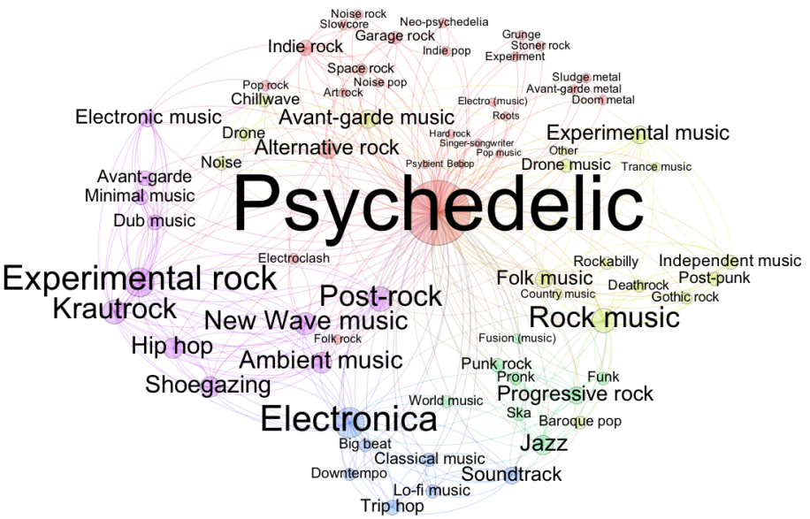
Tool set
(applications)
Search engines
Work space
Search Engine
Analysis
Personal history
(profile)
Visualization 2
Edit tools
Visualization tools
Images
From Wikipedia
External Images
(google or others)
Analysis
tools
Feedback
tools
X
X
Option 1
Option 2
Option 3
Option 4
Social
tools
Chat
Sound
Video
External Video
Sending recommendation and sharing
Analysis
MAKE YOUR OWN TOOL
t Text Text Text
“playlists”
Edit articles
Rate articles
Add own media

Slide 72
Practical example:
Collection of pictures
+
tags
Collection of Songs
+
Music genres
+
composers
Collection of interesting topics
Collection important terms
(keywords)
My own dataset of interest
Redesigning Wikipedia for Education

Slide 73
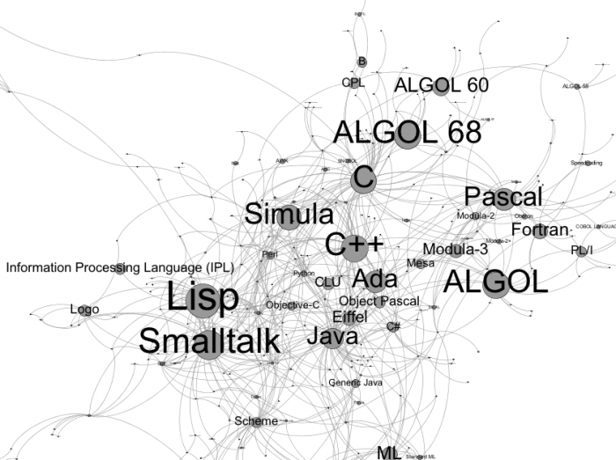
Tool set
(applications)
Search engines
Work space
Search Engine
Data set analysis
Edit tools
Visualization tools
Analysis
tools
Feedback
tools
X
X
Option 1
Option 2
Option 3
Option 4
Social
tools
Upload my own dataset for example: programming language
Share!
With friends
Recommend!
To students

Slide 74
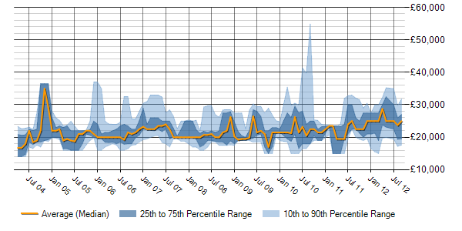
Concept 2: Extensible Framework
People not only contribute to content, but also to usability
Consider present Wikipedia as low level structured database
Create an open app store inside the Wikipedia
Personal App Toolbox
xxx xxxxxxxx xxxxxxx xxxxx xxxxxx
xxx xxxxxxxx xxxxxxx xxxxx xxxxxx
Chat
Video
Analysis
Bookmarking
More
. . .

Slide 75
Example - Discussion
Teachers and students discuss about teaching methods and homework based on certain collection of resources on Wikipedia
Teachers
Studnets
Homework

Slide 76
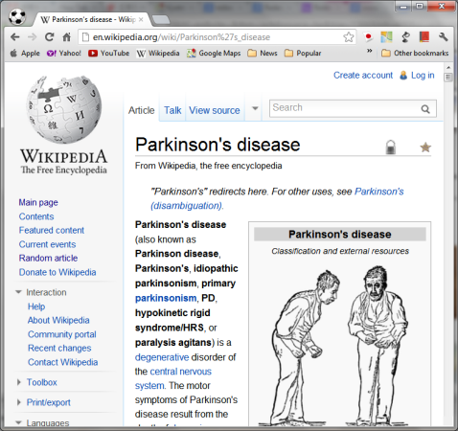
Example – Visualized guiding
Wikipedia is not guiding
Underline link structure is not efficient for learning
Learners need more related concepts and clear leaning path to understand certain topic
?

Slide 77
Example – Visualized guiding
Link relativeness + Interesting + Popular
Designing
A
A
C
C
Swot analysis
D
B
D
B
Brainstorming
Desirables
Designing
Designing
Swot analysis
H
H
Desirables
K
K
E
E
Voting
F
F
G
G
T
T

Slide 78
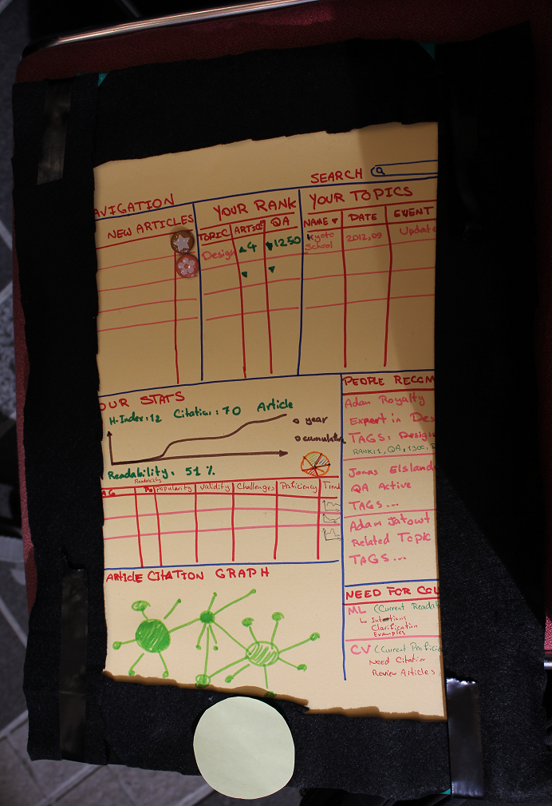
Concept 3: Contributor Motivator
Author Dashboard
Feasible, Technical
Brings Value Added by Data Mining, Motivation for Contributors
Principles Covered: Up-to-Date, Story Telling, Guiding, Honest, Extendable
Redesigning Wikipedia for Education

Slide 79
Author Dashboard: 1
Articles for You
Reading List/ Subscription
Need Referee
Need Expert Review
Need to Moderate
Related Topic
Your Rankings
<Topic , Article Rank , Q&A Rank> list
Show Your Trend in Ranking
Show Your Authorities e.g. Editor, moderator, expert,…
Redesigning Wikipedia for Education – Kourosh Meshgi

Slide 80
Author Dashboard: 2
Your Topics
<Name, Date, Recent Event, Stats> list
Suggested people
<Name, Tag, Reason of Suggestion> list
Reason of Suggestion: Expert, Q&A Active, Related Topic
Call for Contribution (Category)
Low Readability in Category
Low Proficiency in Category
Article Citation Graph
Nodes are Article, size=popularity
Redesigning Wikipedia for Education – Kourosh Meshgi

Slide 81
Author Dashboard: 3
Your Stats
H-Index, Citations, Articles, Q&A Responses
Readability Index
Publication Graph (Annual / Cumulative)
Topic Distribution Tag Cloud
Topic Category Contribution Pie Chart
Topics
<Tag, Popularity, Validity, Proficiency, Trend Graph> list
Redesigning Wikipedia for Education – Kourosh Meshgi

Slide 82
Author Dashboard:
Articles Suggestion
Reading List/ Subscription
For Referral/ Review/Moderation
Related Articles
Redesigning Wikipedia for Education

Slide 83
Author Dashboard:
Authored Articles’ History
Redesigning Wikipedia for Education

Slide 84
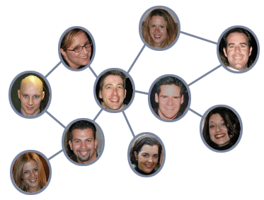
Author Dashboard:
People Suggestion
Redesigning Wikipedia for Education

Slide 85
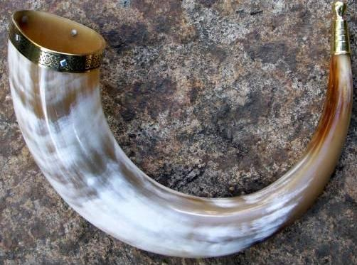
Author Dashboard:
Call for Contribution (Category)
Category Overall Readability Score
Category Inherent Difficulty
Redesigning Wikipedia for Education

Slide 86
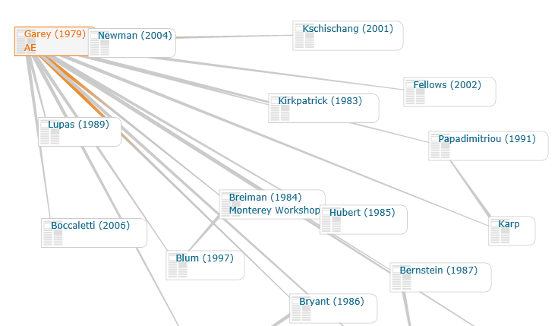
Author Dashboard:
Article Citation Graph
Redesigning Wikipedia for Education

Slide 87
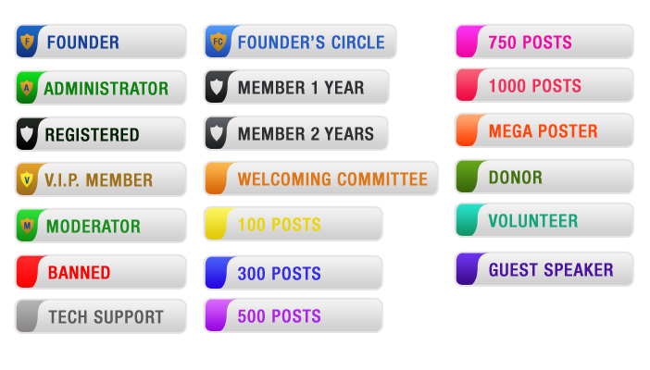
Author Dashboard:
Author Ranking System
Rankings
Wall of Fame
Show Your Authorities
Redesigning Wikipedia for Education

Slide 88
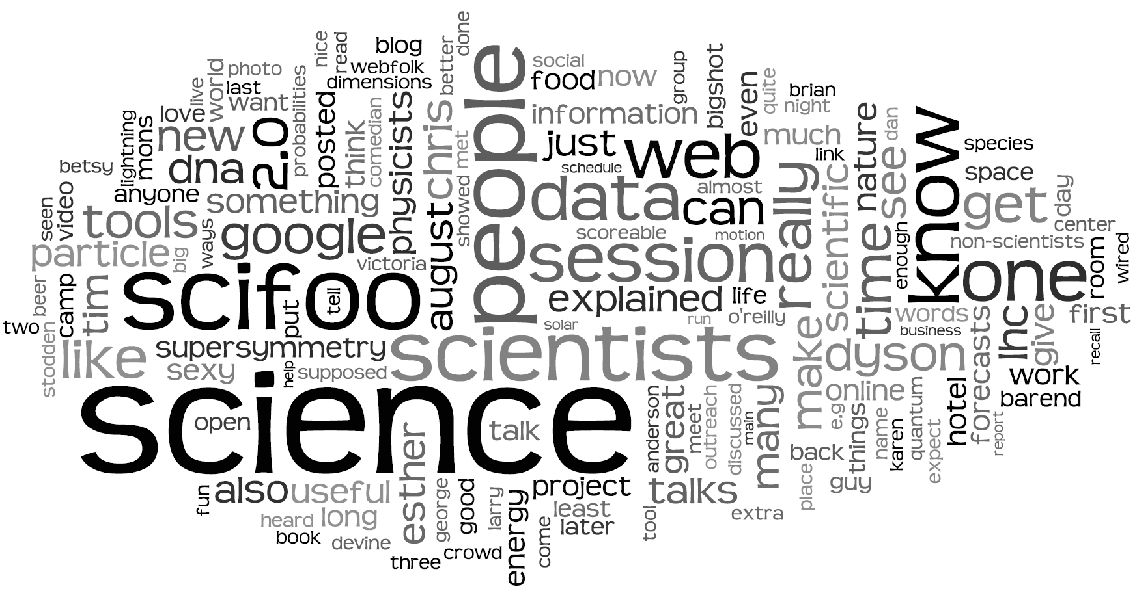
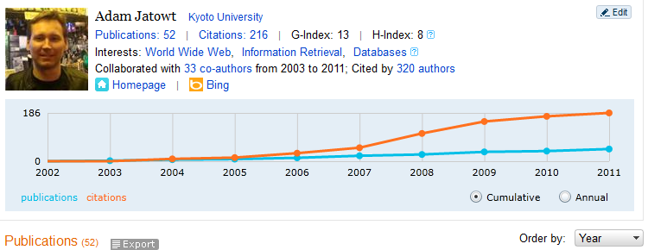
Author Dashboard:
Your Stats
Readability Index
Redesigning Wikipedia for Education

Slide 89
Thank You!
Redesigning Wikipedia for Education

